Slide 1
Service Daily Record
2023, AUG, 4

Slide 2
Acknowledgement
We would like to express our deepest gratitude to our committed teacher, Daw Myo Myo Than Naing, and our supportive parents. Their invaluable contribution has been instrumental in our academic pursuits. Their unwavering support and guidance have helped us navigate the complexities of programming, problem-solving, and software development. We are thankful for our teacher's patience and expertise, which have equipped us with essential skills and knowledge. Our parents' relentless encouragement has been a motivating force, inspiring us to excel and make meaningful contributions to the field. With their continued belief in our abilities, we are emboldened to pursue our software engineering journey with passion and determination.

Slide 3
Team
Our team only consists of two members: Thura Min Thein and
Zaw Myat Minn.

Slide 4
Description
This application is designed for Service Technicians who need to maintain a daily record of their services. It is window-based and developed using Java Swing.

Slide 5
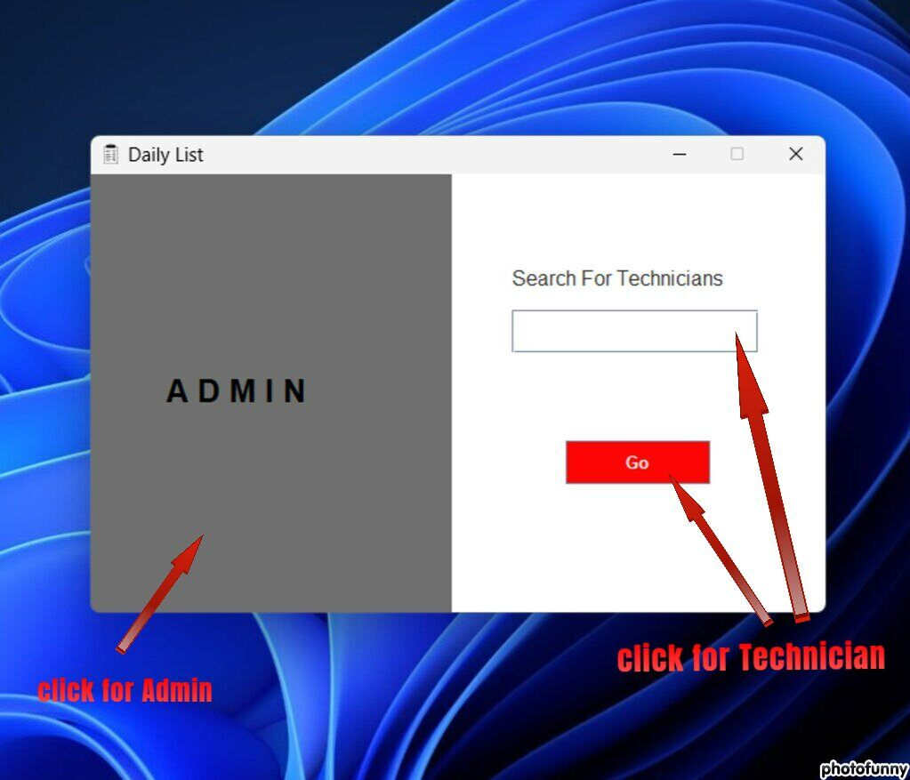
Main UI
When running this application, the first thing we will see is a figure. When it reaches a certain point, there will be two options available: (1) Admin and (2) Service Technician.

Slide 6
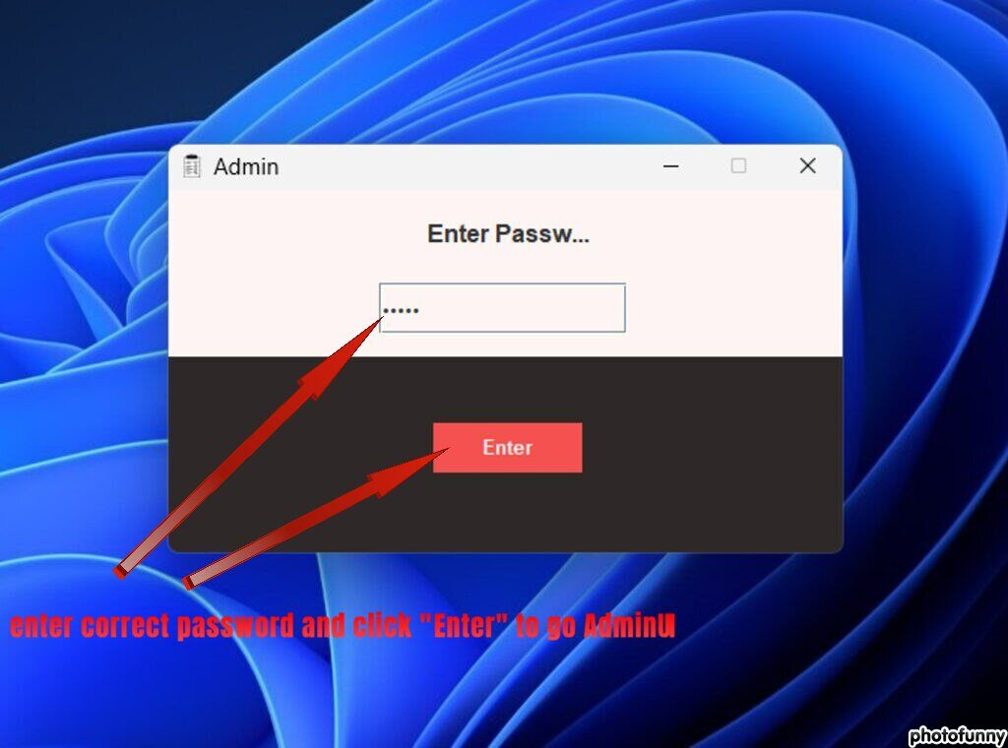
A D M I N
In order to access the Admin panel, a password is required as indicated in the figure. However, in this particular application, the Admin password is always set as "admin".

Slide 7
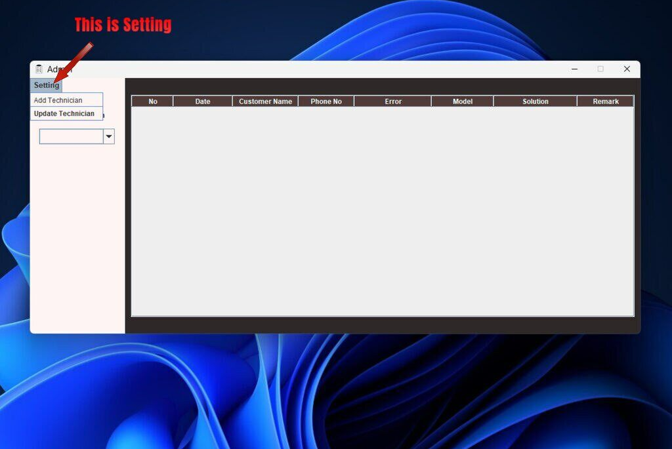
Setting
Once you enter the correct password, the admin UI will display as shown in the figure. Within the settings, there are two options available: adding a technician or updating an existing technician's information.

Slide 8
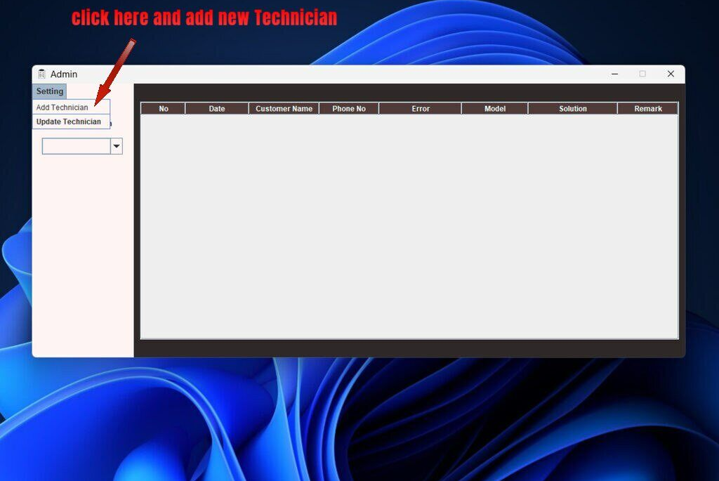
Add Technician
The administrator has the ability to add a new technician to the system.

Slide 9
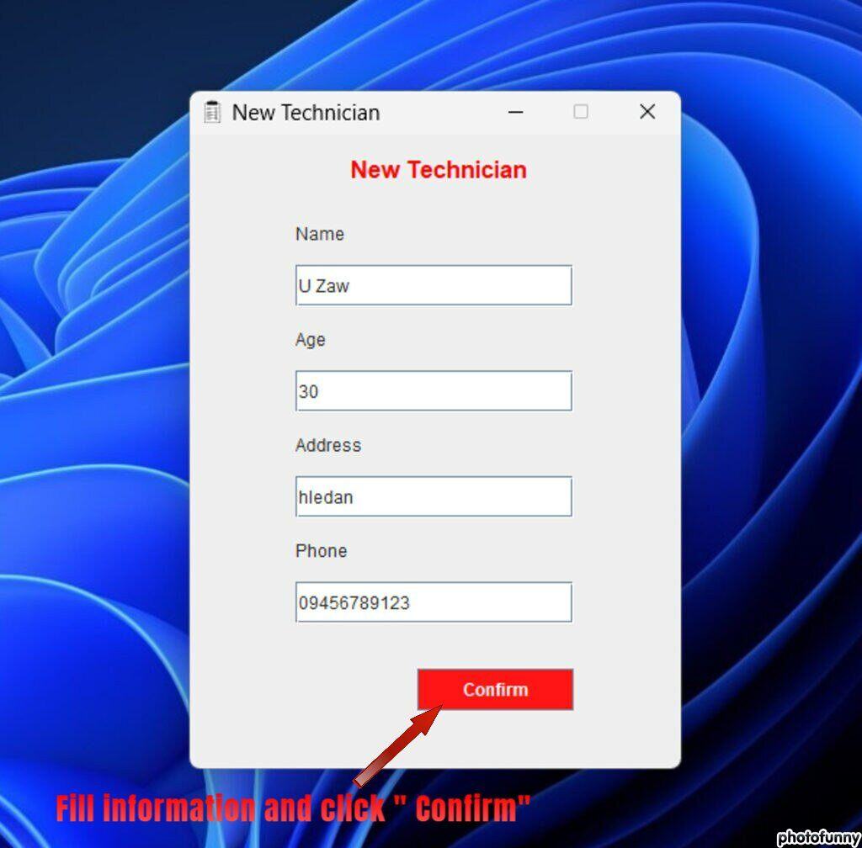
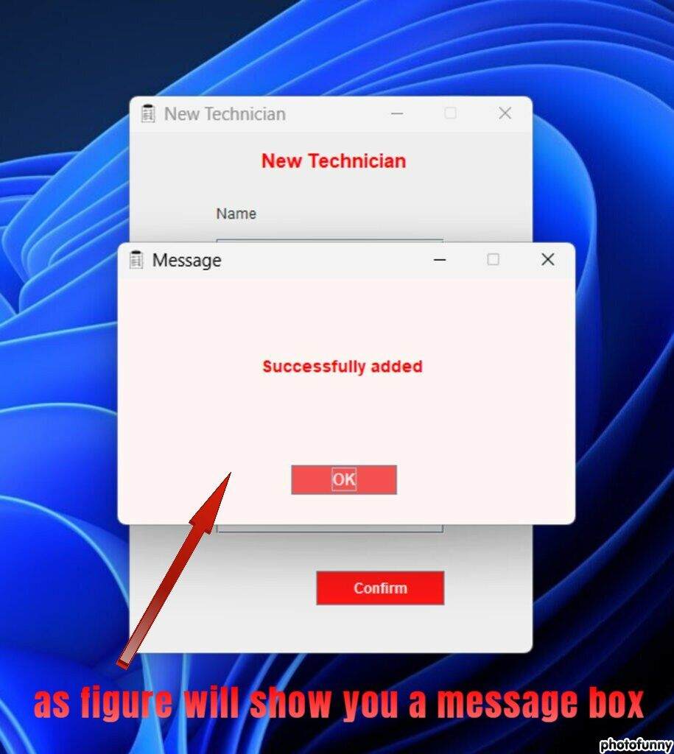

Slide 10
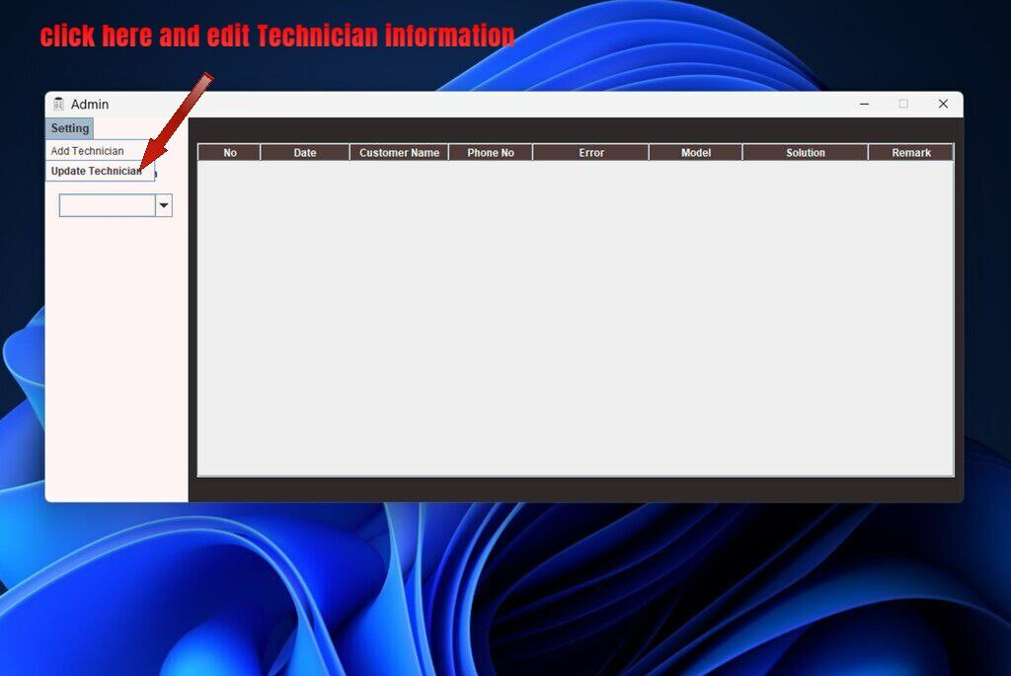
Update Technician
The administrator can update information regarding the technicians.

Slide 11
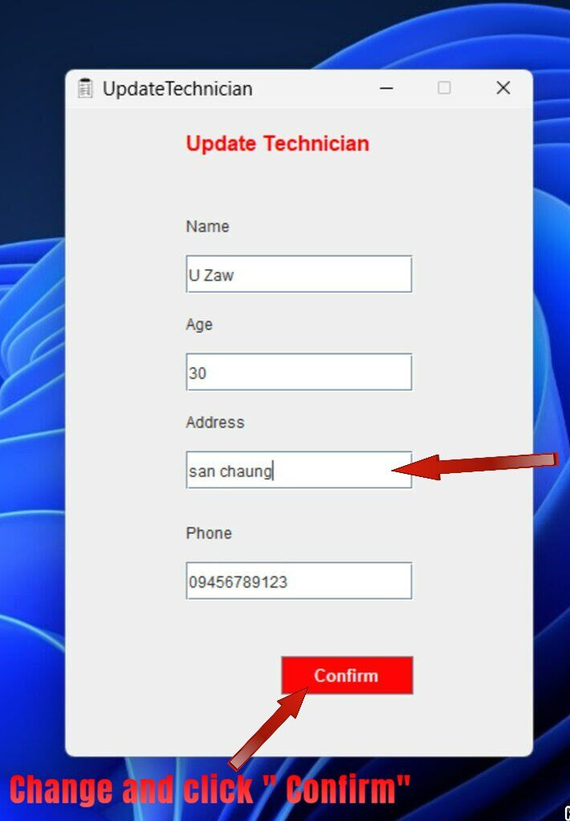
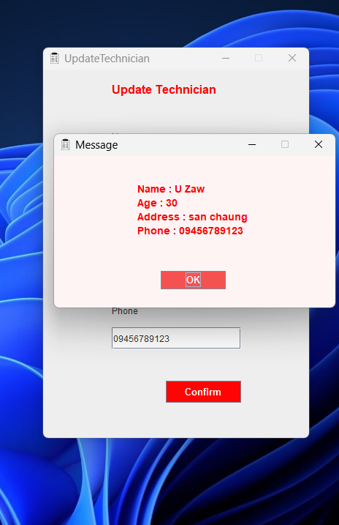
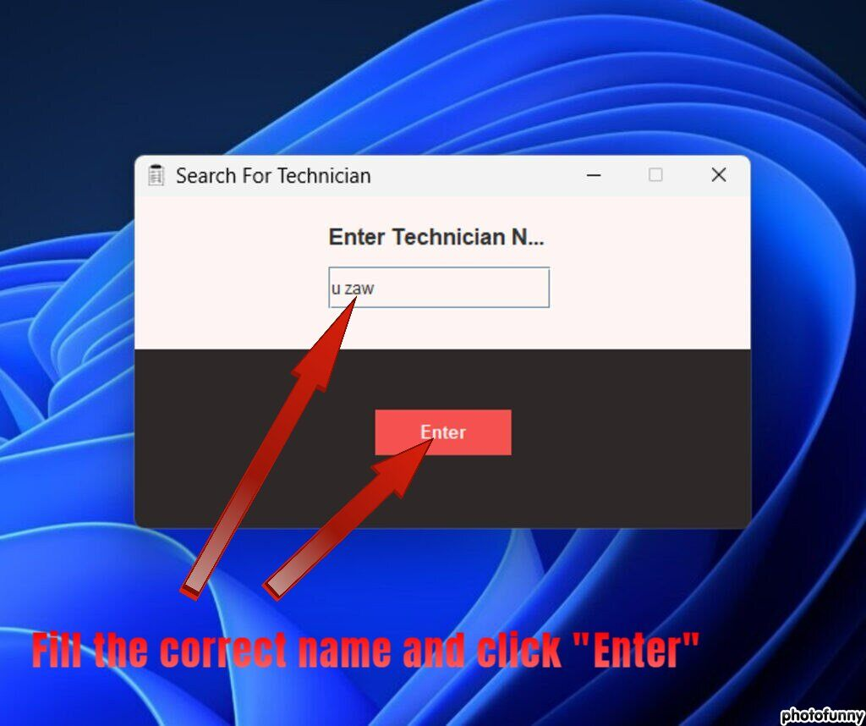

Slide 12
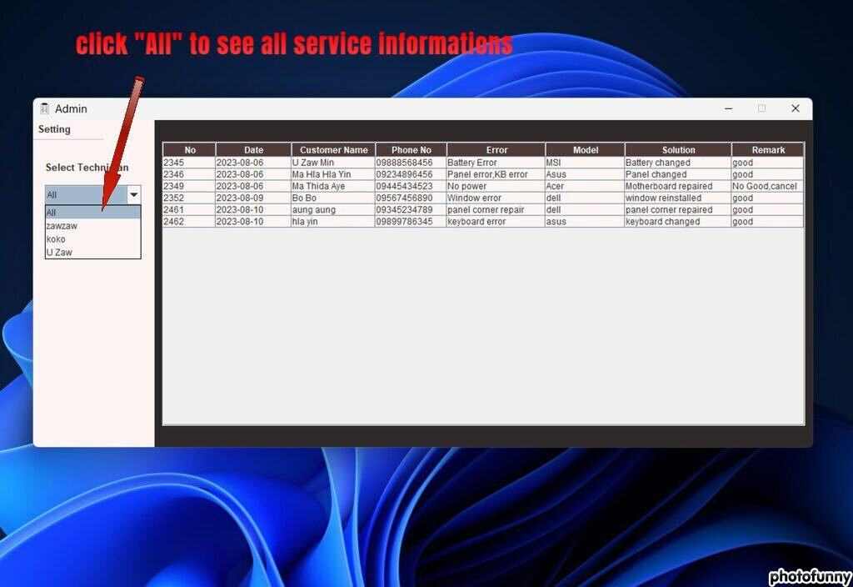
Select Technician
The administrator is able to view all service details individually.

Slide 13
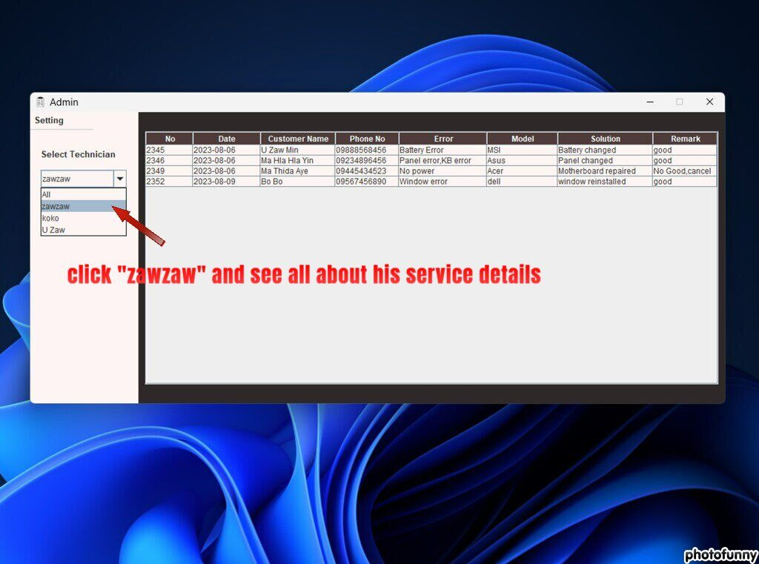

Slide 14
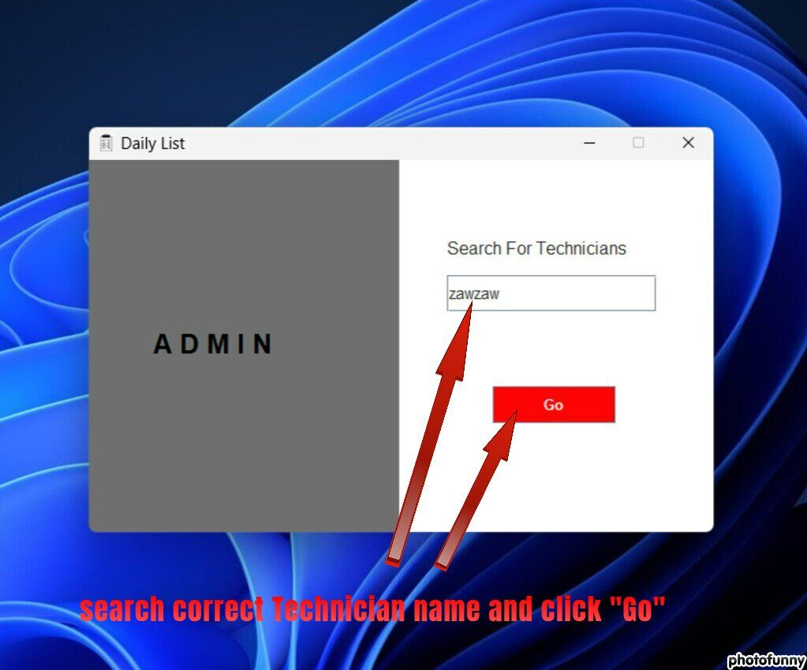
Search for Technicians
As a user, you are a service technician responsible for filling in detailed service information and saving it to the database. To access your worksheets, it's important to search for your name accurately in the search box. If any errors occur, error messages will be displayed to help you correct them.

Slide 15
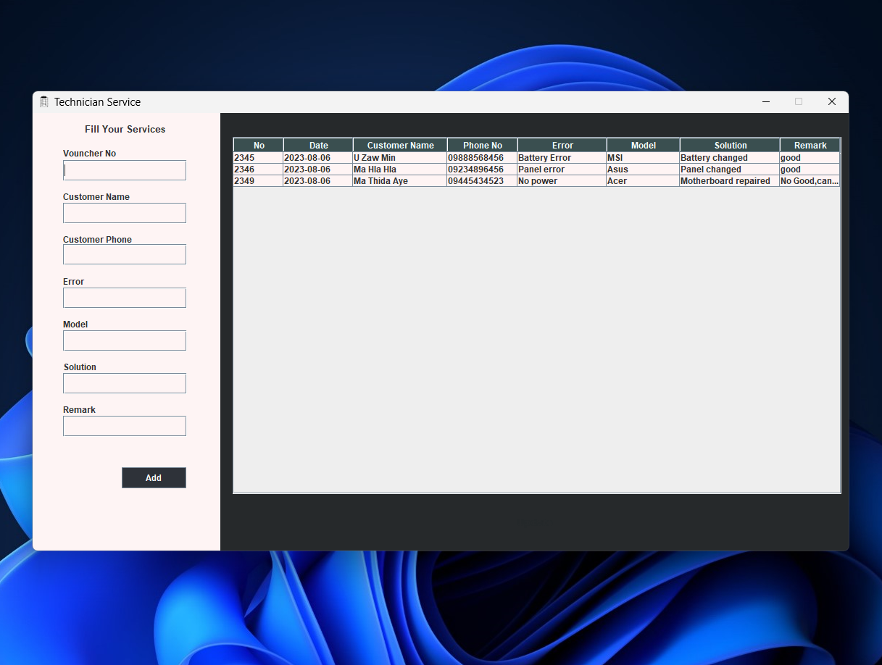
You will find the service information of the technician you have entered.

Slide 16
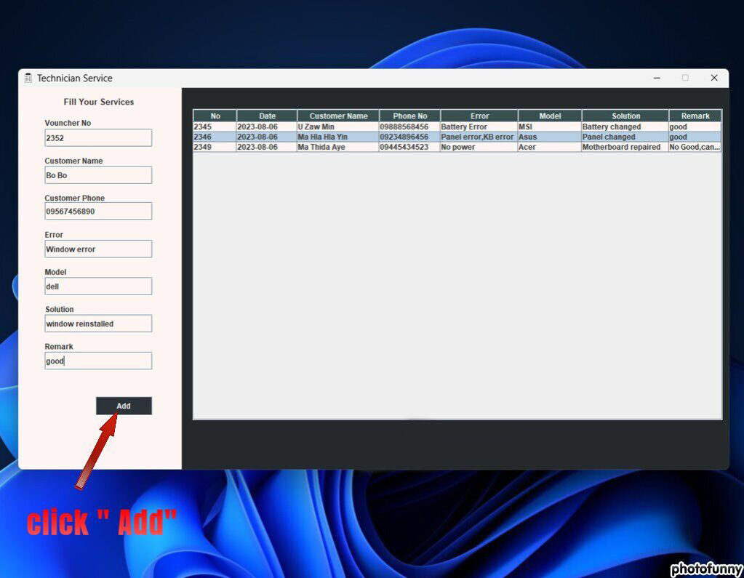
Technician Service
Technicians can document their daily work using the form in the figure, which automatically generates the current date.

Slide 17
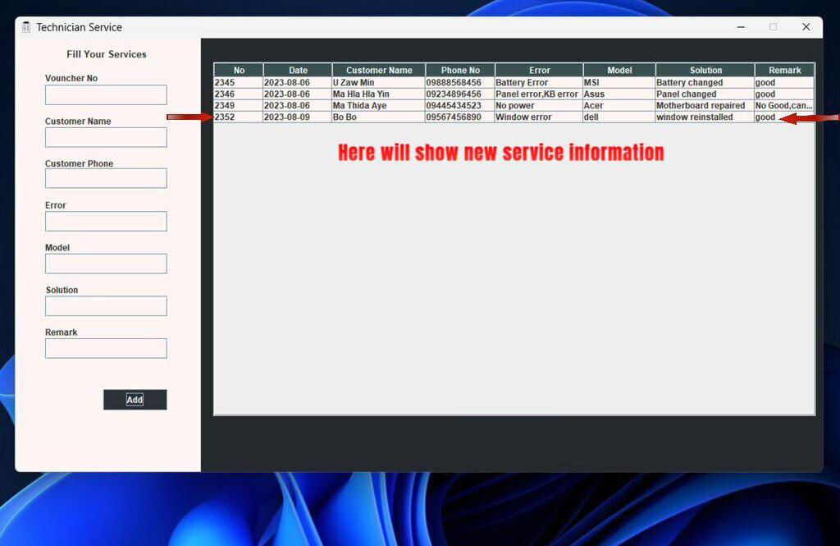

Slide 18
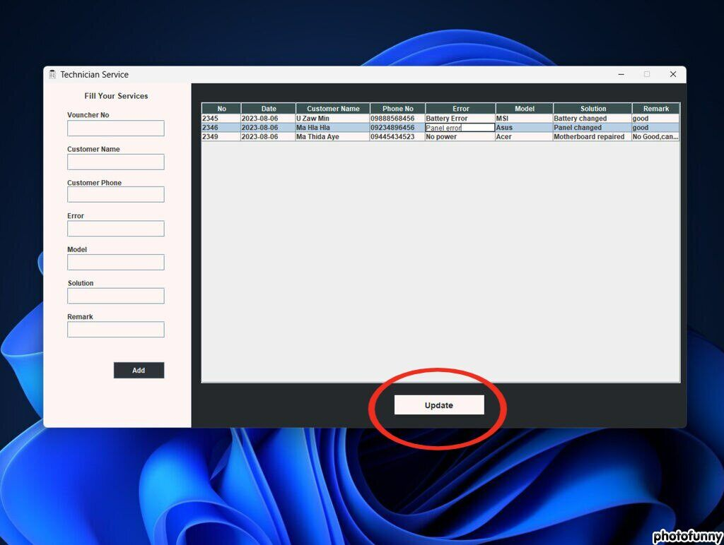
Clicking on the table will reveal the "Update" button to edit information.

Slide 19
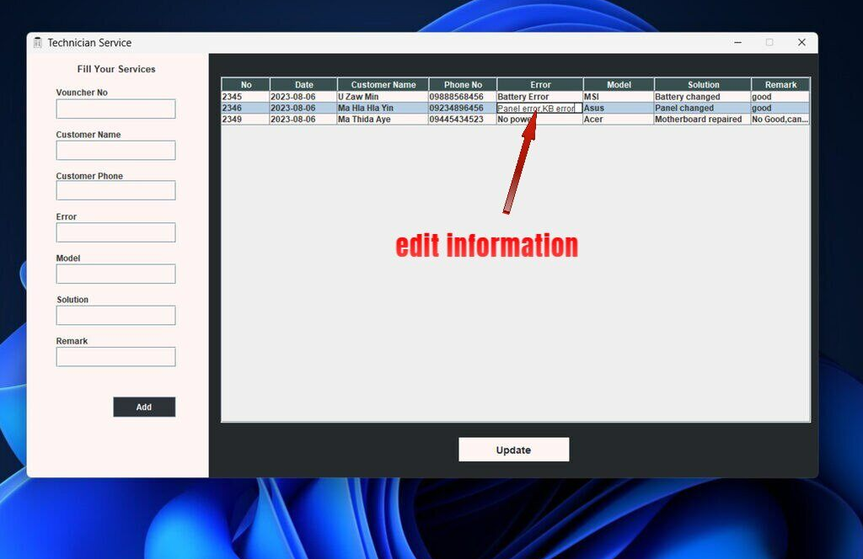

Slide 20
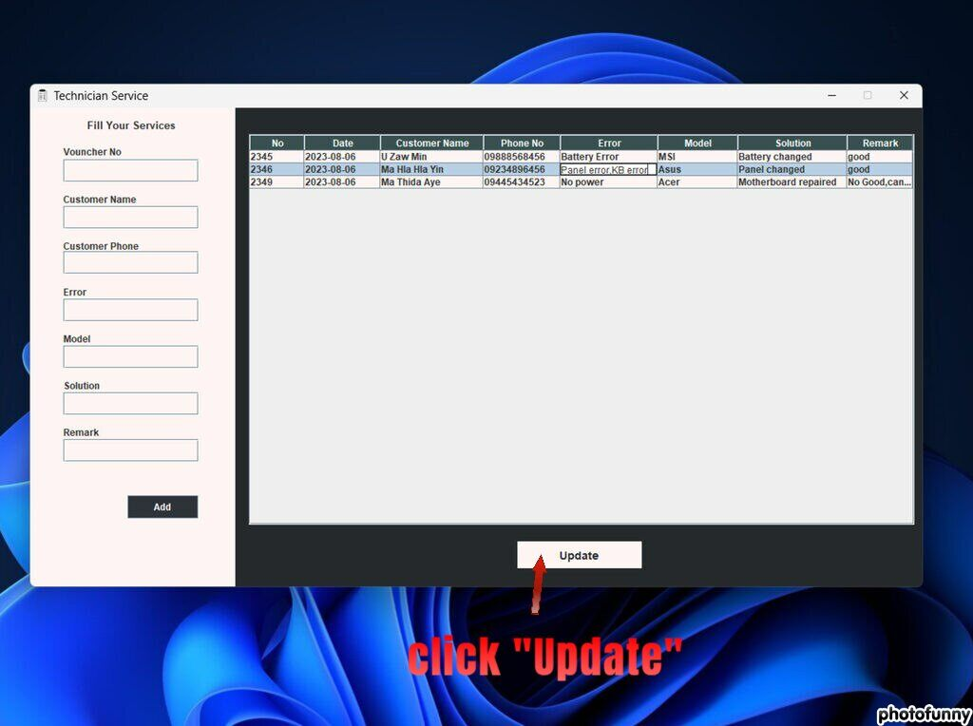

Slide 21
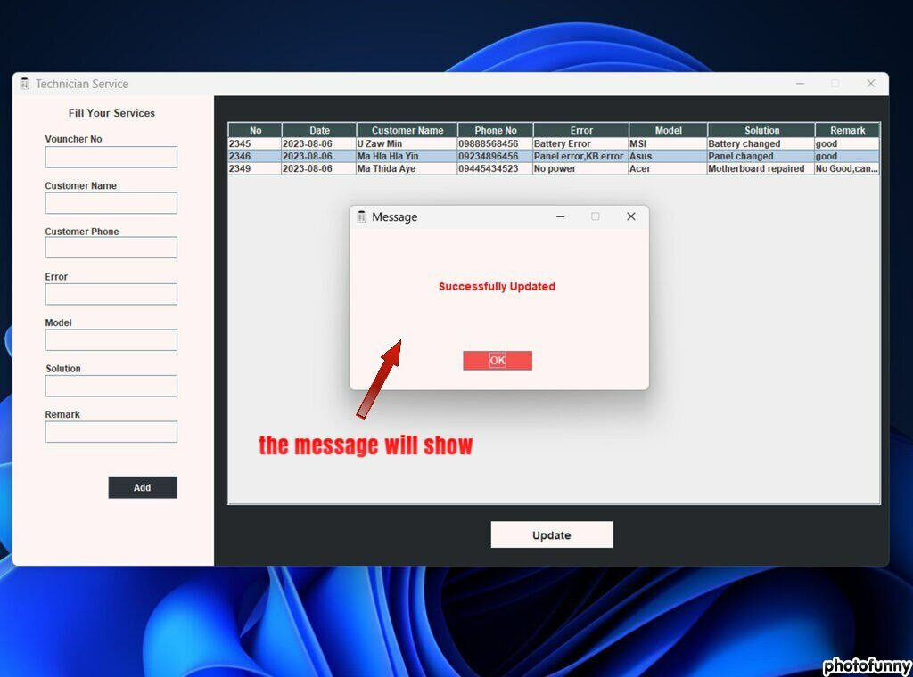

Slide 22
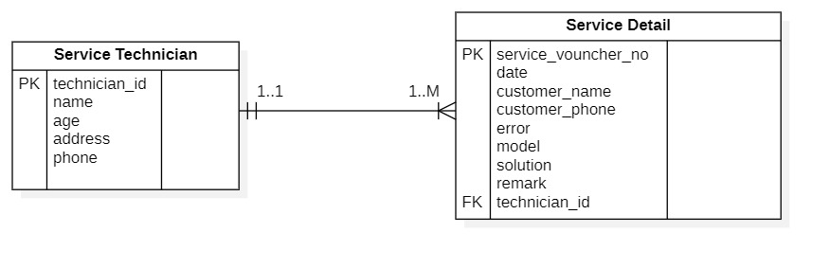
ER diagram for Database

Slide 23
MySQL Query for Database
create database dailylist;
create table dailylist.service_technician(
technician_id int not null primary key unique auto_increment,
name varchar(50),
age int,
address varchar(50),
phone varchar(20));
create table dailylist.service_detail(
service_vouncher_no int not null primary key unique,
date date,
customer_name varchar(50),
customer_phone varchar(20),
error varchar(1000),
model varchar(50),
solution varchar(1000),
remark varchar(1000),
technician_id int,
foreign key (technician_id) references dailylist.service_technician(technician_id) on delete cascade on update cascade);

